Slide 1
Design and Analysis of Algorithms
Shortest Paths I(Ch24)

Slide 2
Design and Analysis of Algorithms
Shortest Paths I
Topics:
Shortest paths
Dijkstra’ algorithm

Slide 3

Paths in graphs
Consider a digraph G=(V,E), with edge-weight function w : E→R. The weight of path p=v₁→v₂--…→v_{k} is defined to be
w(p)=∑_{i=1..k-1}w(v_{i} ,v_{i+1})
Example:

Slide 4
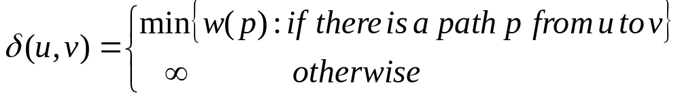
Shortest paths
A shortest path from u to v is a path of minimum weight from u to v. The shortest-path weight form u to v is defined as

Slide 5

Optimal structure
Theorem. A subgraph of shortest path is a shortest path.
Proof. Cut and paste:

Slide 6
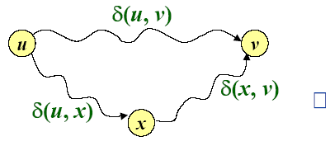
Triangle inequality
Theorem. For all u,v,x∈V, we have
δ(u,v) ≤δ(u,x)+δ(x,v)
Proof.

Slide 7
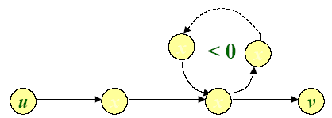
Well-definedness of shortest paths
If a graph G contains a negative-weight cycle, then some shortest paths may not exist.

Slide 8
Single-source shortest paths
Problem. From a given source vertex s∈V, find the shortest-path weightδ(s,v) for all v∈V.
If all edge weight w(u,v) are nonnegative, all shortest-path weights must exist.
IDEA: Greedy
1. Maintain a set S of vertices whose shortest-path distances from s are known
2. At each step add to S the vertex v∈V-S whose distance estimate from s is minimal.
3. Update the distance estimates of vertices adjacent to v.

Slide 9
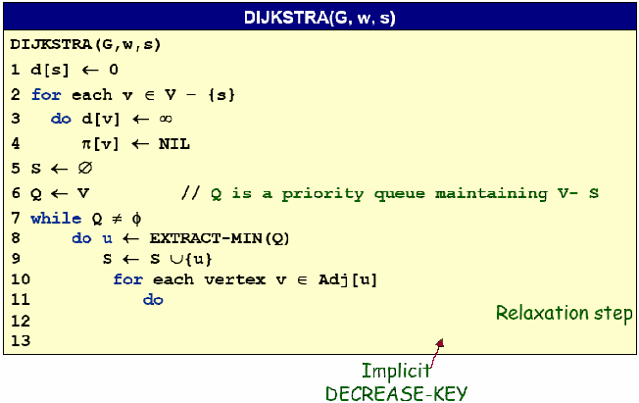

Dijkstra’s algorithm

Slide 10
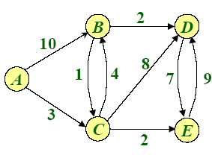
Example of Dijkstra’s algorithm
Graph with nonnegative edge weights:

Slide 11
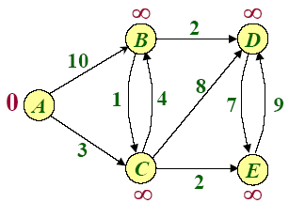
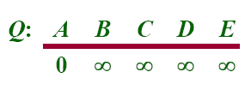

Example of Dijkstra’s algorithm
Initialize:

Slide 12

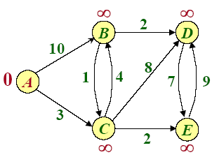


Example of Dijkstra’s algorithm

Slide 13
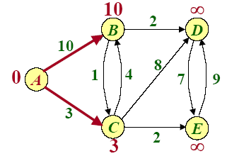
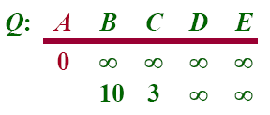
Example of Dijkstra’s algorithm
Relax all edges leaving A :

Slide 14

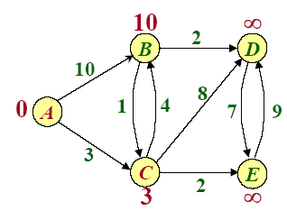
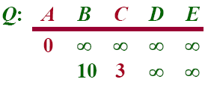

Example of Dijkstra’s algorithm

Slide 15
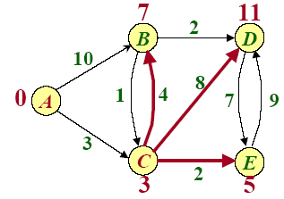
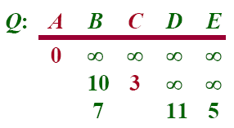
Example of Dijkstra’s algorithm
Relax all edges leaving C :

Slide 16

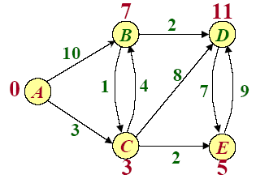
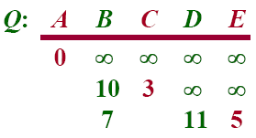

Example of Dijkstra’s algorithm

Slide 17
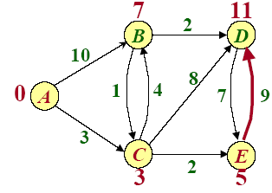
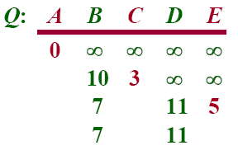
Example of Dijkstra’s algorithm
Relax all edges leaving E :

Slide 18

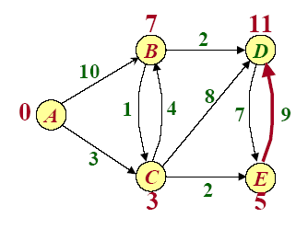
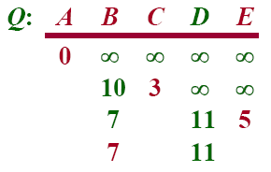

Example of Dijkstra’s algorithm

Slide 19
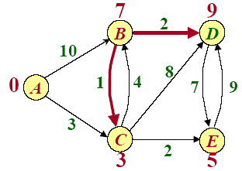
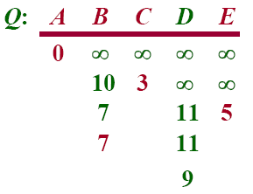
Example of Dijkstra’s algorithm
Relax all edges leaving B :

Slide 20

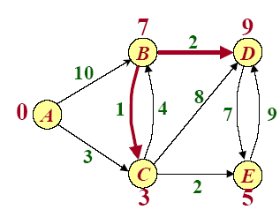
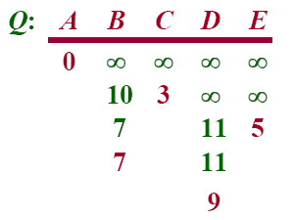

Example of Dijkstra’s algorithm

Slide 21
Simple Review
Knapsack Problem
  0/1
Huffman codes
Shortest paths
  Dijkstra’s algorithm

Slide 22
Example of Dijkstra’s algorithm

Slide 23
Dijkstra’s algorithm

Slide 24
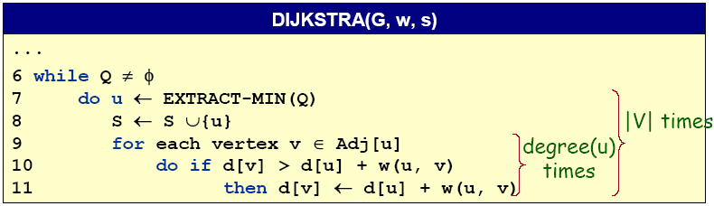
Analysis of Dijkstra’s algorithm
Hanshaking Lemma→Θ(E) implicit DECREASE-KEY’s
Time=Θ(V.T_{EXTRACT-MIN}+E.T_{DECREASE-KEY})
Note: Same formula as in the analysis of Prim’s minimum spanning tree algorithm.

Slide 25
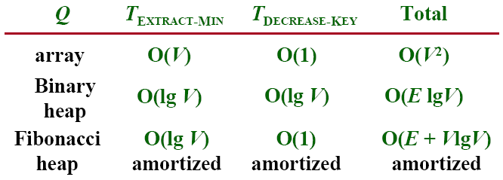
Analysis of Dijkstra’s algorithm
Time=Θ(V.T_{EXTRACT-MIN}+E.T_{DECREASE-KEY})

Slide 26
Example of Dijkstra’s algorithm
-8
9

Slide 27
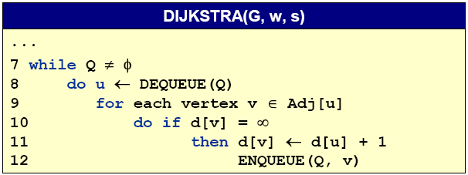
Unweighted graphs
Suppose that w(u,v)=1 for all (u,v) ∈E. Can Dijkstra’s algorithm be improved?
-- Use a simple FIFO queue instead of a priority queue.
Breadth-first search
Analysis: Time=O(V+E)

Slide 28
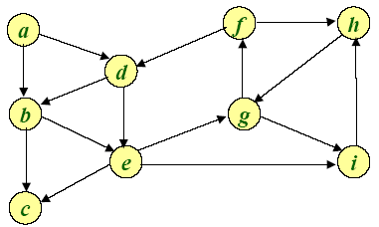
Example of Breadth-first search
Q:

Slide 29
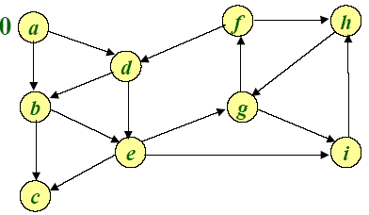
Example of Breadth-first search
0
Q: a

Slide 30
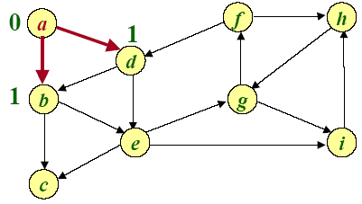
Example of Breadth-first search
1 1
Q: a b d

Slide 31
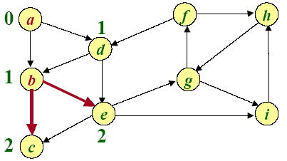
Example of Breadth-first search
1 2 2
Q: a b d c e

Slide 32
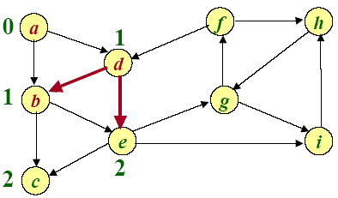
Example of Breadth-first search
2 2
Q: a b d c e

Slide 33
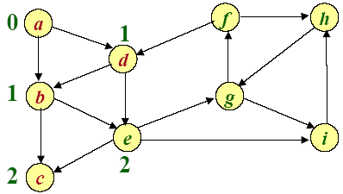
Example of Breadth-first search
2
Q: a b d c e

Slide 34
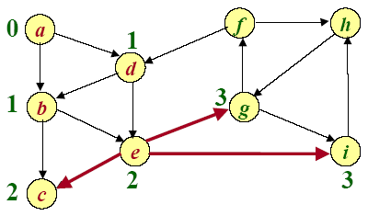
Example of Breadth-first search
3 3
Q: a b d c e g i

Slide 35
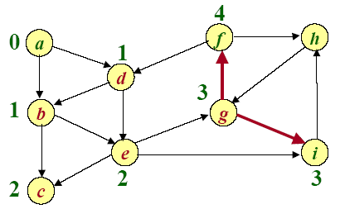
Example of Breadth-first search
3 4
Q: a b d c e g i f

Slide 36
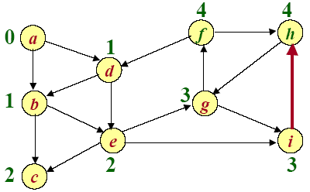
Example of Breadth-first search
4 4
Q: a b d c e g i f h

Slide 37
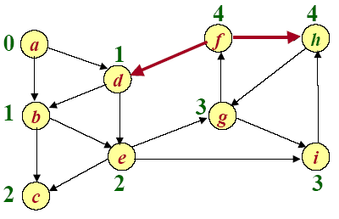
Example of Breadth-first search
4
Q: a b d c e g i f h

Slide 38
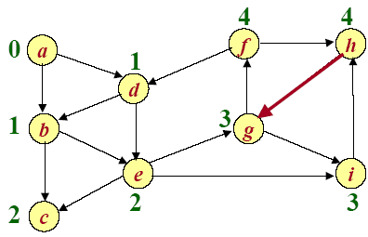
Example of Breadth-first search
Q: a b d c e g i f h

Slide 39
Design and Analysis of Algorithms
Navigation in a Small World
Reference:
The small world web by Lada A. Adamic
The small-world phenomenon: an algorithmic perspective by J. Kleinberg
Diameter of the World-Wide Web by Albert, Nature
Perspective: network analysis—the structure of the web by Kleinberg and Lawrence, Science

Slide 40
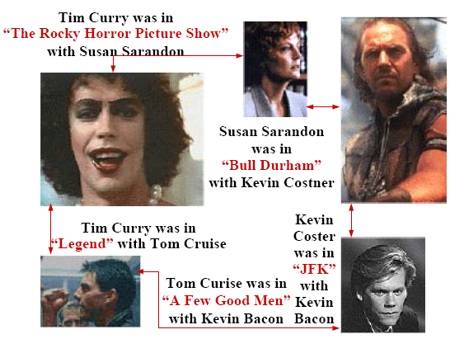
Small World Phenomenon

Slide 41
Small World Phenomenon
Small world phenomenon.
-- Six handshakes away from anyone else in the world.
-- Long a matter of folklore.
-- “It’s a small world after all.”
Stanley Milgram experiment (1960s) quantified effect.
-- You are given personal info of another person in US, e.g., occupation.
-- Goal: deliver message.
-- Restriction: can only forward to someone you know by first name.
-- Outcome: message delivered with average of 5 intermediaries.
Application demands new ADT.
-- Graph = data type that represents pairwise connections.
-- Vertex = element.
-- Edge = connection between two vertices.

Slide 42
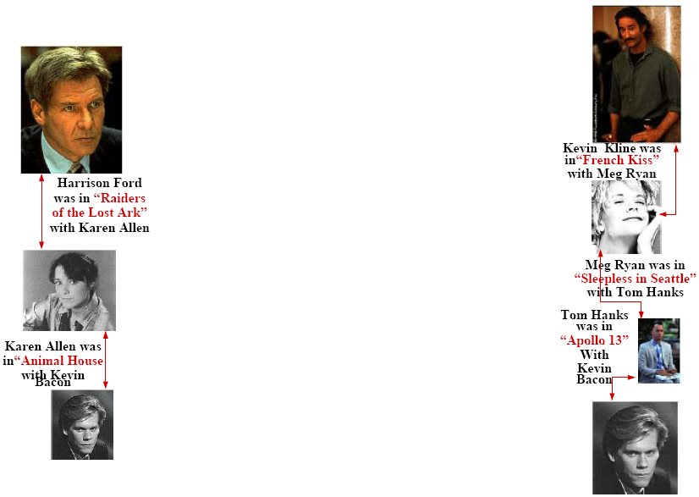

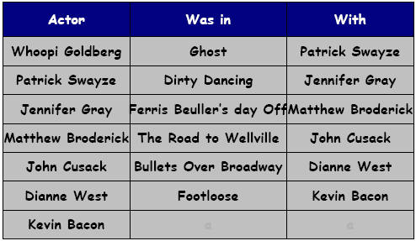
Kevin Bacon Game
Game: given actor, find chain of movies connecting them to Kevin Bacon

Slide 43
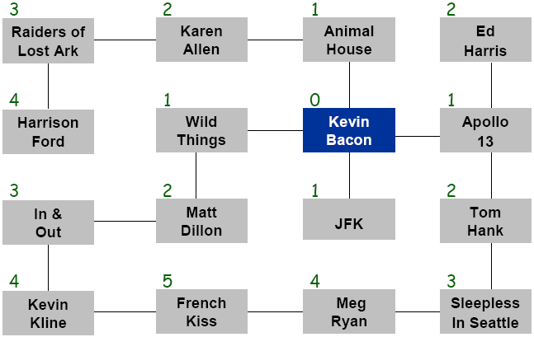
Bacon numbers
Bacon number: length of shortest such chain to Kevin Bacon.
How to compute: find shortest path in graph, and divide length by 2.

